Slide 1

Python Programming
Machine Learning with Scikit-Learn

Slide 2
Feedback is greatly appreciated!

Slide 3
Objective
What is machine learning
Classification
Scientific packages

Slide 4
What is Machine Learning?

Slide 5
Machine Learning
Subfield of Artificial Intelligence (AI)
Building blocks to make computers learn to behave more intelligently
It is a theoretical concept. There are various techniques with various implementations

Slide 6
What is it used for?
Fraud detection.
Web search results.
Real-time ads on web pages
Credit scoring and next-best offers.
Prediction of equipment failures.
New pricing models.
Network intrusion detection.
Recommendation Engines.
Customer Segmentation.
Text Sentiment Analysis.
Predicting Customer Churn.
Pattern and image recognition.
Email spam filtering.
Financial Modeling.

Slide 7
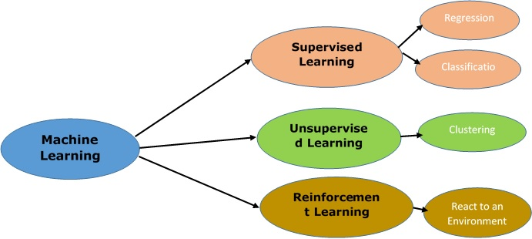
Types of Algorithms

Slide 8
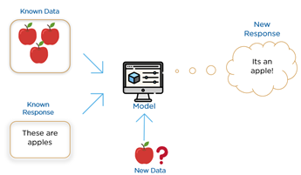
Supervised Learning
The correct classes of the training data are known

Slide 9
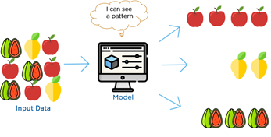
Unsupervised Learning
The correct classes of the training data are not known

Slide 10
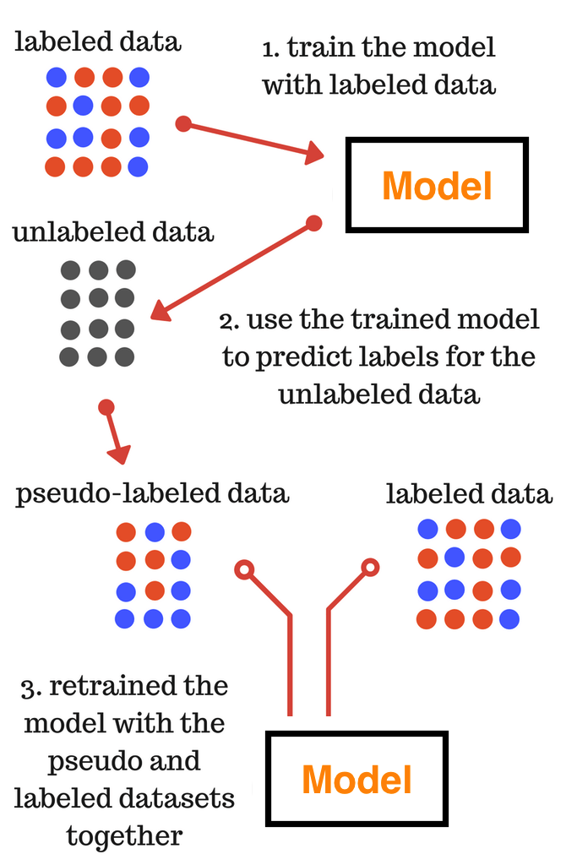
Semi-Supervised Learning
A mix of Supervised and Unsupervised learning

Slide 11
Terminology
Features
The number of features or distinct traits that can be used to describe each item in a quantitative manner.
Samples
A sample is an item to process (e.g. classify). It can be a document, a picture, a sound, a video, a row in database or CSV file, or whatever you can describe with a fixed set of quantitative traits.
Feature vector
an n-dimensional vector of numerical features that represent some object.
Feature extraction
Preparation of feature vector .
Transforms the data in the high-dimensional space to a space of fewer dimensions.
Training/Evolution set
Set of data to discover potentially predictive relationships.

Slide 12
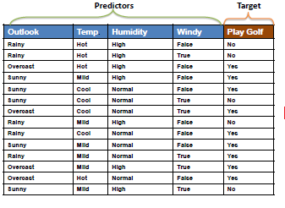
Sample dataset: play golf: Yes or No

Slide 13
Machine Learning Techniques

Slide 14
Techniques
classification: predict class from observations
clustering: group observations into "meaningful" groups
regression (prediction): predict value from observations

Slide 15
Classification

Slide 16
Types of classification algorithms
Nearest Neighbor (k-nearest neighbors (kNN))
Naive Bayes Classifier
Support Vector Machines (SVM)
Decision Trees
Boosted Trees
Random Forest
Neural Networks
https://medium.com/@sifium/machine-learning-types-of-classification-9497bd4f2e14
https://www.analyticsvidhya.com/blog/2017/09/common-machine-learning-algorithms/

Slide 17
k-nearest neighbors (k-NN)

Slide 18
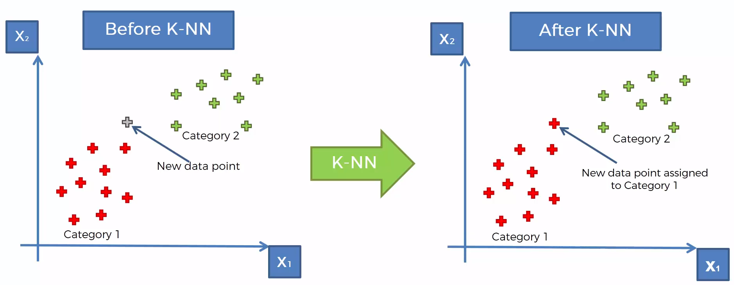
k-nearest neighbors (k-NN)
https://www.udemy.com/machinelearning/learn/v4/content
https://www.quora.com/How-is-the-k-nearest-neighbor-algorithm-different-from-k-means-clustering

Slide 19
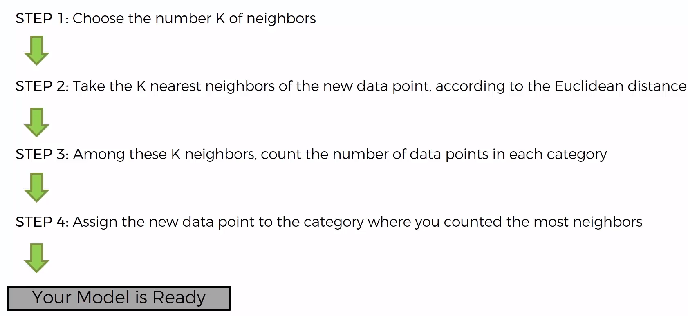
k-nearest neighbors (k-NN)
https://www.udemy.com/machinelearning/learn/v4/content
https://www.quora.com/How-is-the-k-nearest-neighbor-algorithm-different-from-k-means-clustering

Slide 20
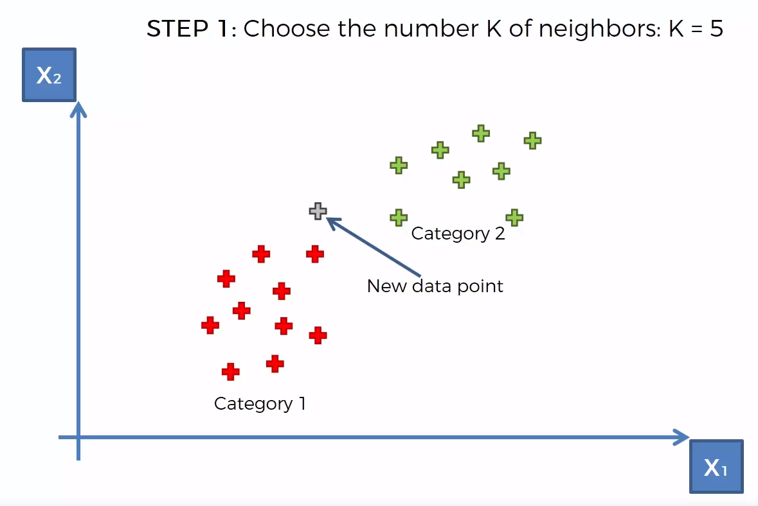
k-nearest neighbors (k-NN)
https://www.udemy.com/machinelearning/learn/v4/content
https://www.quora.com/How-is-the-k-nearest-neighbor-algorithm-different-from-k-means-clustering

Slide 21
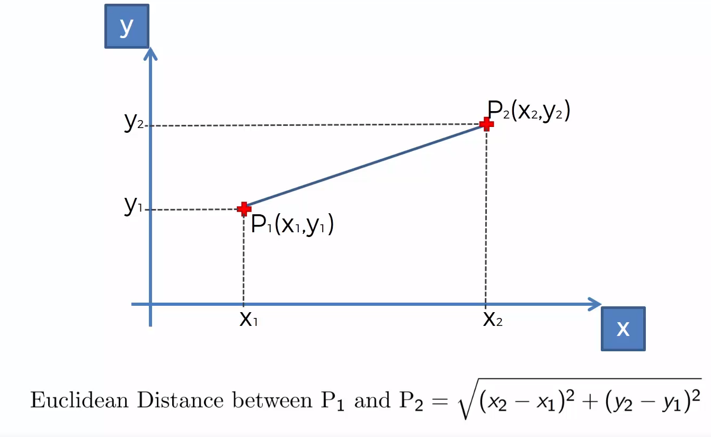
k-nearest neighbors (k-NN)
https://www.udemy.com/machinelearning/learn/v4/content
https://www.quora.com/How-is-the-k-nearest-neighbor-algorithm-different-from-k-means-clustering

Slide 22
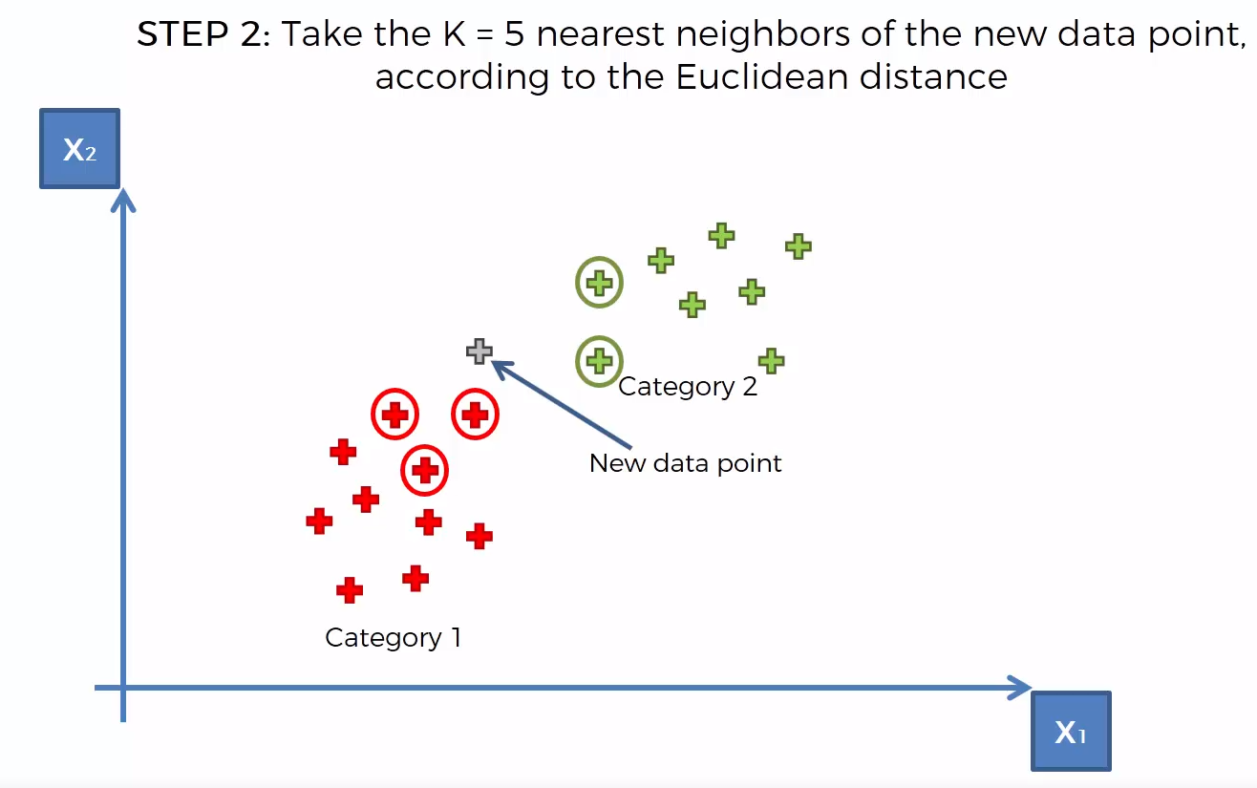
k-nearest neighbors (k-NN)
https://www.udemy.com/machinelearning/learn/v4/content
https://www.quora.com/How-is-the-k-nearest-neighbor-algorithm-different-from-k-means-clustering

Slide 23
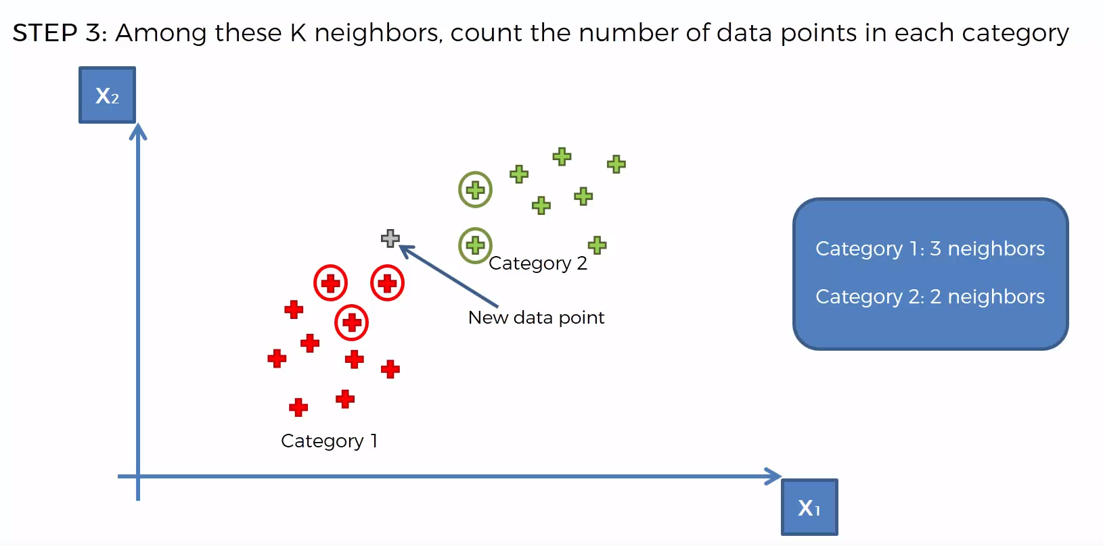
k-nearest neighbors (k-NN)
https://www.udemy.com/machinelearning/learn/v4/content
https://www.quora.com/How-is-the-k-nearest-neighbor-algorithm-different-from-k-means-clustering

Slide 24
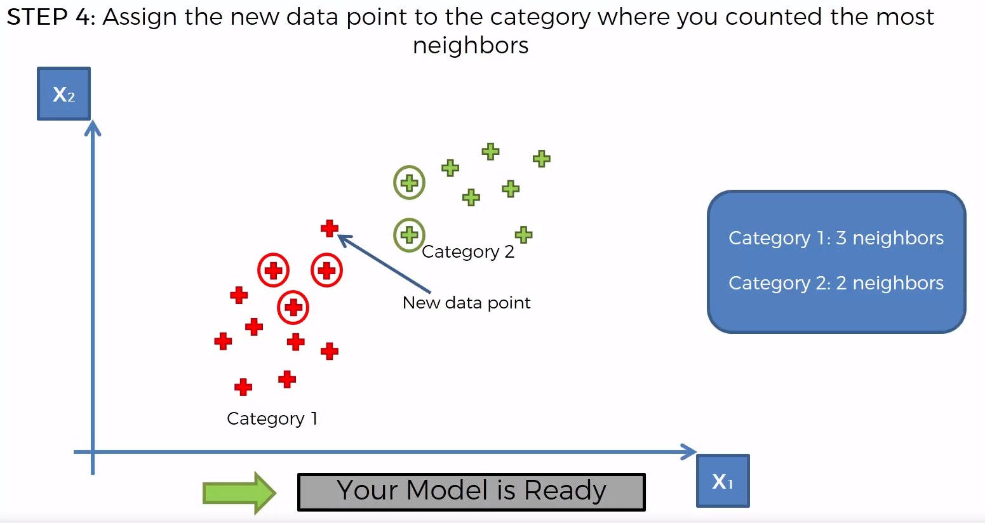
k-nearest neighbors (k-NN)
https://www.udemy.com/machinelearning/learn/v4/content
https://www.quora.com/How-is-the-k-nearest-neighbor-algorithm-different-from-k-means-clustering

Slide 25
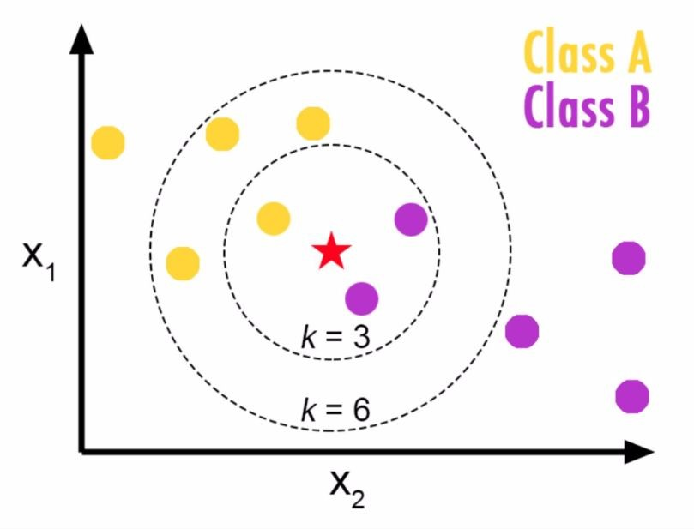
k-nearest neighbors (k-NN)
Choosing a K will affect what class a new point is assigned to:

Slide 26
Naive Bayes Classifier

Slide 27
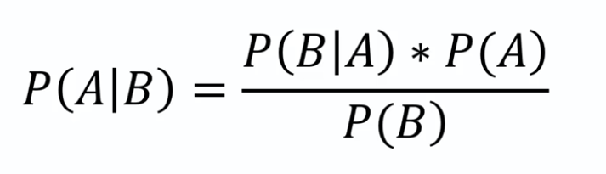
Naive Bayes Classifier
It is a classification technique based on Bayes’ Theorem assumption of independence among predictors.
A Naive Bayes classifier assumes that the presence of a particular feature in a class is unrelated to the presence of any other feature
Bayes’ Theorem
https://medium.com/@sifium/machine-learning-types-of-classification-9497bd4f2e14

Slide 28
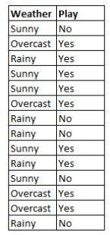
Naïve Bayes
We are training dataset of weather and corresponding target variable ‘play’ (suggesting possibility of playing)
Now we need to decide wether players play or not based on weather condition

Slide 29
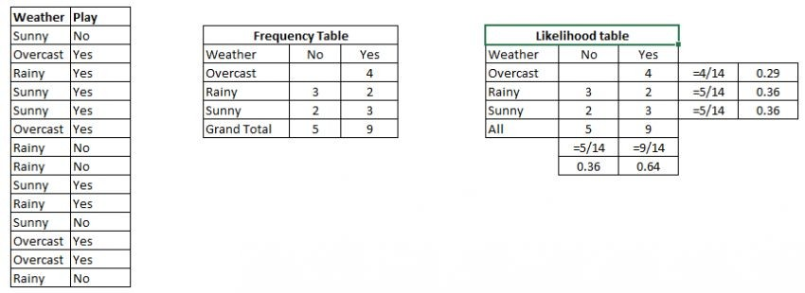
Convert data set to frequency table
Create likelihood table by finding the probabilities like overcast = 0.29 and probability of playing is 0.64
Now use the naïve bayes equation to calculate the posterior probability for each class.
The class with the highest probability is the outcome of prediction

Slide 30
Players will play if the weather is sunny:
P(Yes|Sunny) = P(Sunny|Yes)*P(Yes)/P(Sunny)
P(Sunny|Yes)=3/9 = 0.33,
P(Sunny)= 5/14=0.36,
P(Yes)=9/14=0.64
Now, P(Yes|Sunny) = 0.33*0.64 /0.36 =0.60, (high probability)

Slide 31
P(No|Sunny) = P(Sunny| No)*P(No)/P(Sunny)
P (Sunny| No)=2/5 = 0.4,
P(Sunny)=5/14=0.36,
P(No)=5/14=0.36
Now, P(No |Sunny) = 0.4*3.6 /0.36 =0.40, (low probability

Slide 32
Support Vector Machines (SVM)

Slide 33
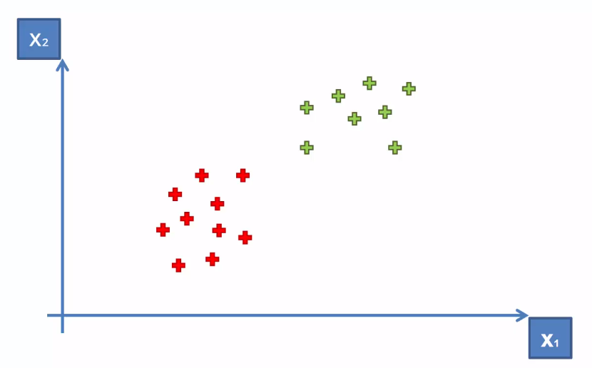
Support Vector Machines (SVM)
Purpose of the classifier is how we can create a boundary between two classes
How can we separate these points?
https://www.udemy.com/machinelearning/learn/v4/content
https://medium.com/@sifium/machine-learning-types-of-classification-9497bd4f2e14

Slide 34
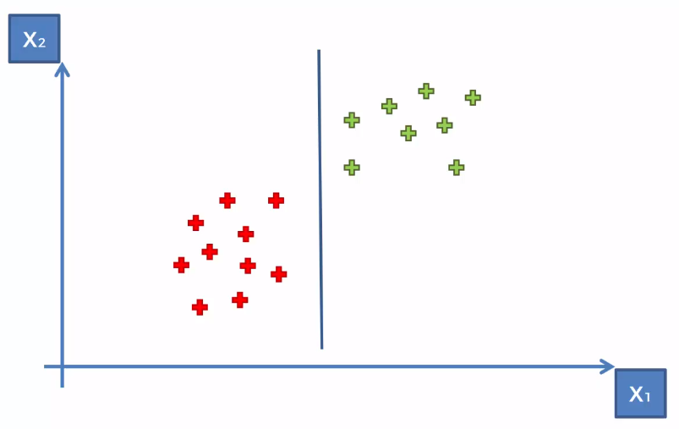
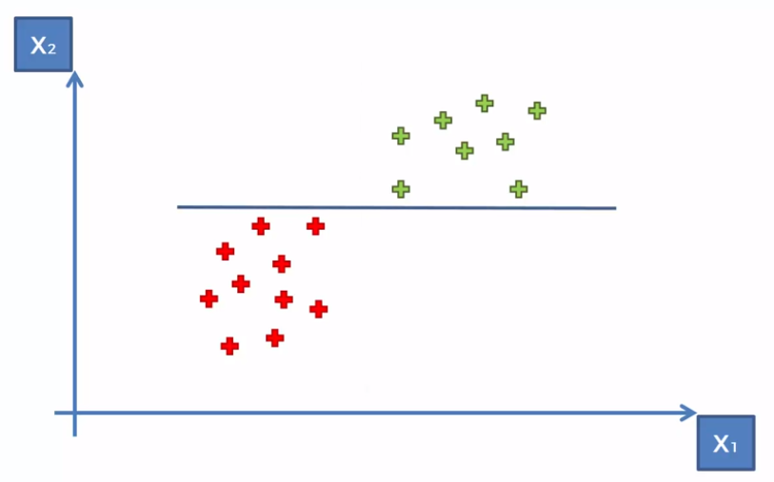
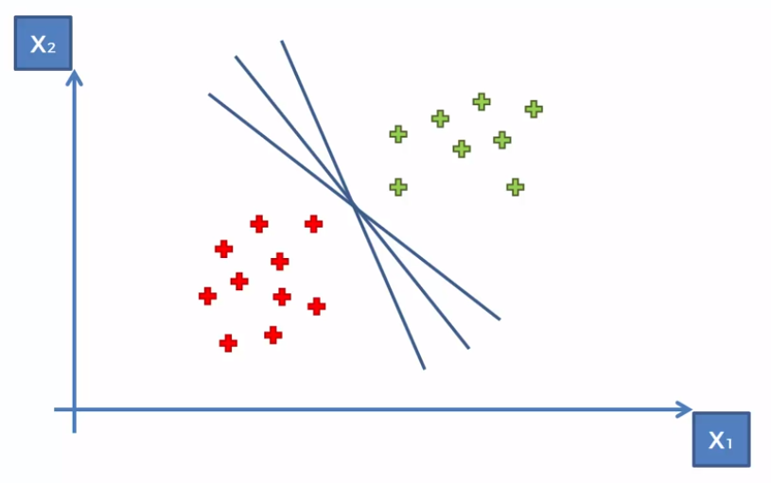
Support Vector Machines (SVM)
How can we separate these points?
https://www.udemy.com/machinelearning/learn/v4/content
https://medium.com/@sifium/machine-learning-types-of-classification-9497bd4f2e14

Slide 35
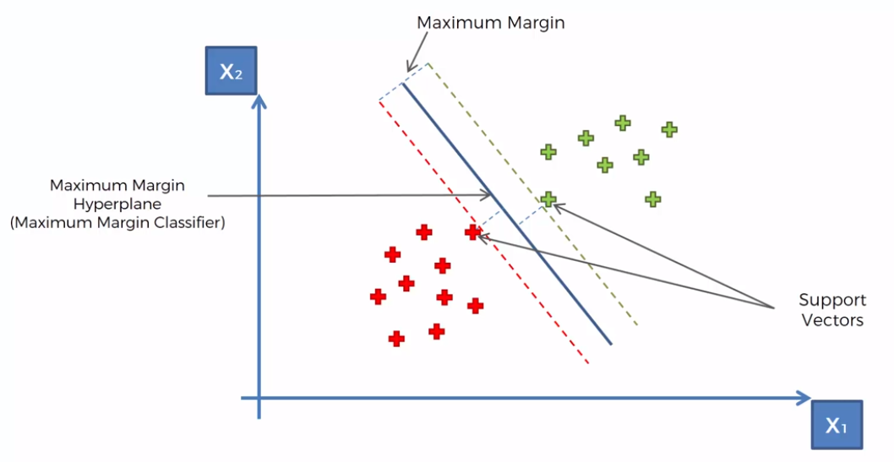
Support Vector Machines (SVM)
https://www.udemy.com/machinelearning/learn/v4/content
https://medium.com/@sifium/machine-learning-types-of-classification-9497bd4f2e14

Slide 36
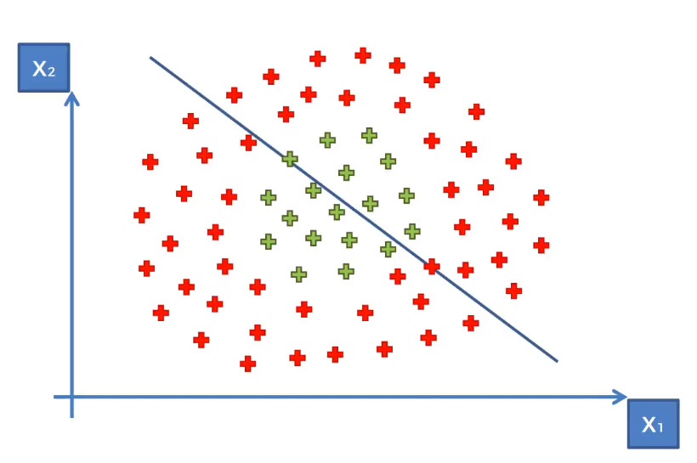
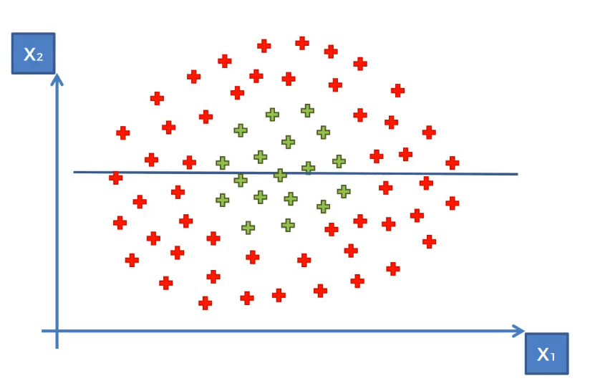
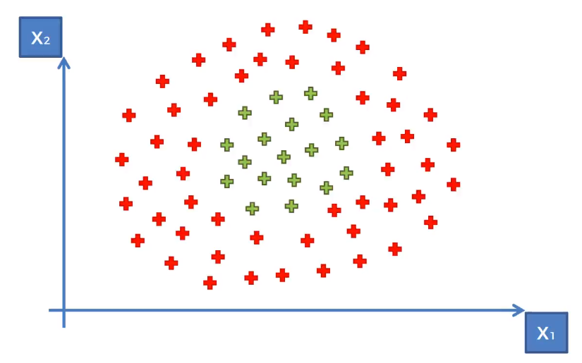
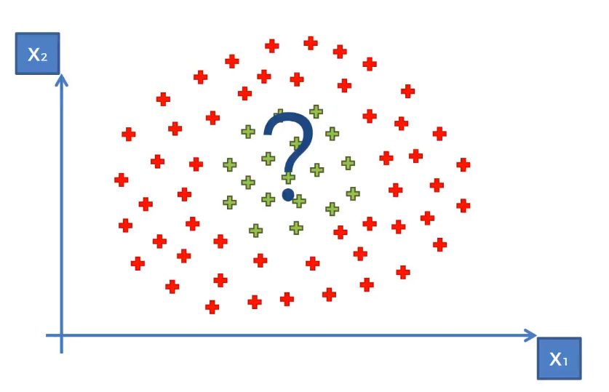
Kernel SVM
What about these points?
https://www.udemy.com/machinelearning/learn/v4/content
https://medium.com/@sifium/machine-learning-types-of-classification-9497bd4f2e14

Slide 37
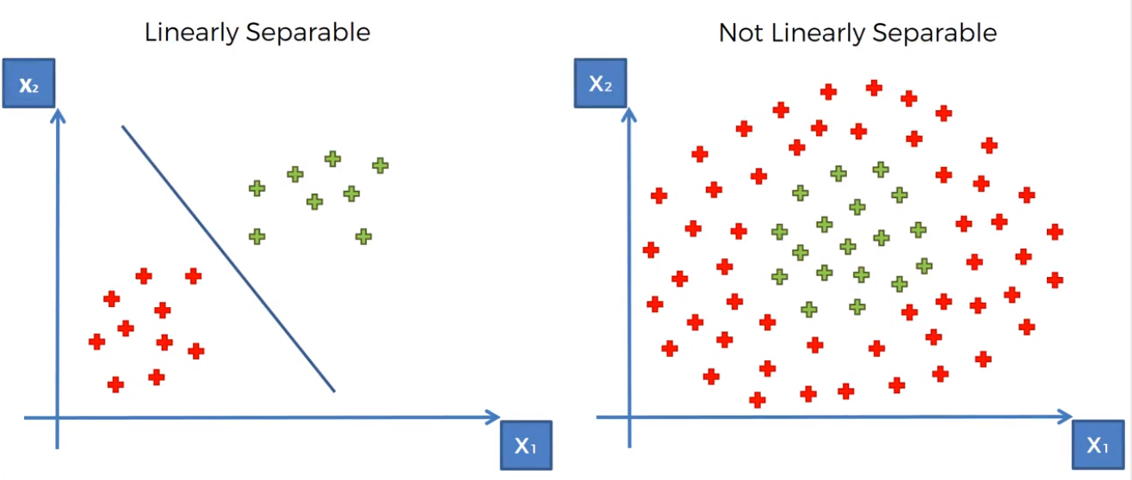
Kernel SVM
Liner Separability
https://www.udemy.com/machinelearning/learn/v4/content
https://medium.com/@sifium/machine-learning-types-of-classification-9497bd4f2e14

Slide 38
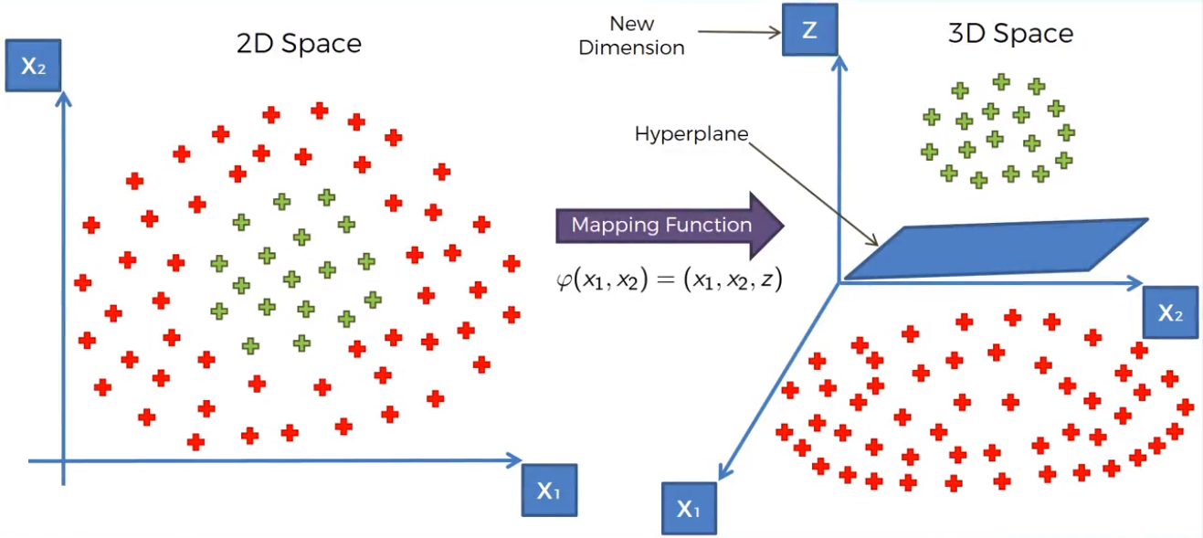
Kernel SVM
Mapping to higher dimension
https://www.udemy.com/machinelearning/learn/v4/content
https://medium.com/@sifium/machine-learning-types-of-classification-9497bd4f2e14

Slide 39
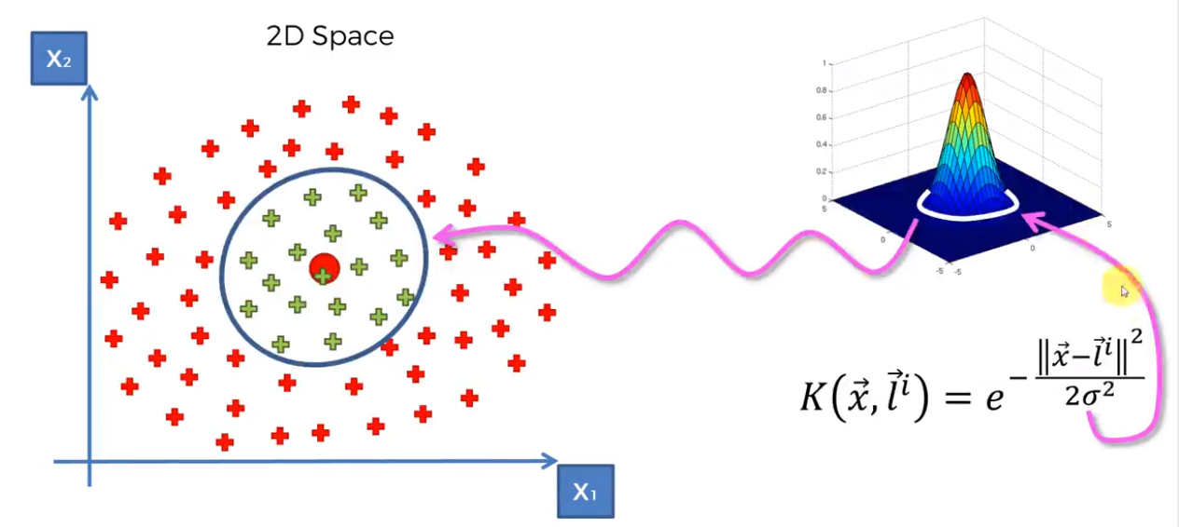
Kernel SVM
The Gaussian RBF Kernel
https://www.udemy.com/machinelearning/learn/v4/content
https://medium.com/@sifium/machine-learning-types-of-classification-9497bd4f2e14

Slide 40
How to know our model is good

Slide 41
Evaluating Model
A machine learning model’s performance is considered good based on its prediction and how well it generalizes on an independent test dataset
Based on the performance of different models we choose the model which ranks highest in performance.
When we have an input x and we apply a function f on the input x to predict an output y. Difference between the actual output and predicted output is the error.
Our goal with machine learning algorithm is to generate a model which minimizes the error of the test dataset.

Slide 42
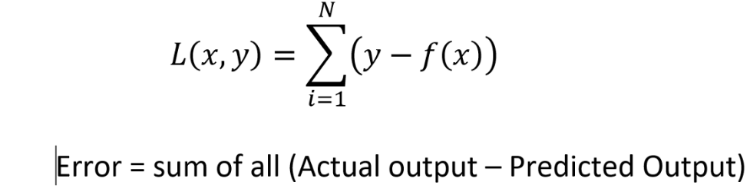
Evaluating Model
Models are assessed based on the prediction error on a new test dataset

Slide 43
Classification
False Positives & False Negatives
Confusion Matrix
Accuracy
Precision
Recall
F1 score

Slide 44
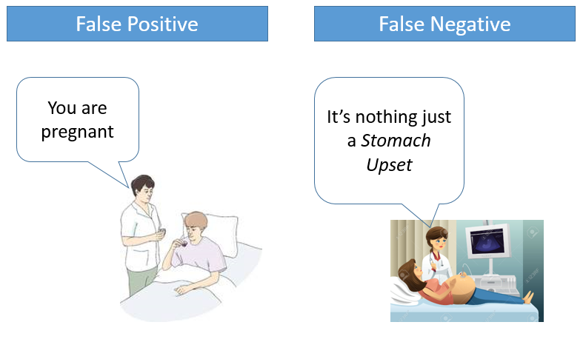
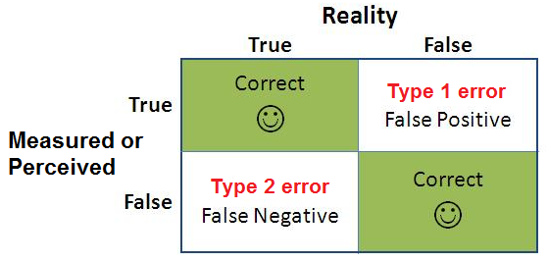
False Positives & False Negatives
A false positive is where you receive a positive result for a test, when you should have received a negative results. A false positive is usually called a Type I error.
A false negative is where you receive a negative test result, but you should have got a positive test result . A false negative is usually called a Type II error.
http://www.statisticshowto.com/false-positive-definition-and-examples/

Slide 45
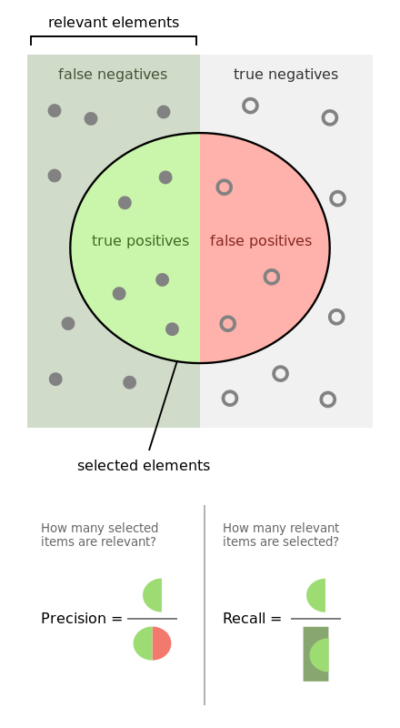
Metrics
accuracy =
true positives + true negatives / total
precision =
true positives / (true positives + false positives)
recall =
true positives / (false negatives + true positives)
F1 score =
2 * ((precision * recall) / (precision + recall))

Slide 46
An architecture for operationalizing Machine Learning algorithms

Slide 47
Build Phase
Training Data
Feature Vectors
Estimation Algorithm
Labels
Operational Phase
New Data
Feature Vectors
Predictive Model
Prediction
Architecture of Machine Learning Operations

Slide 48
Your Task
Given a data set of instances of size N, create a model that is fit from the data (built) by extracting features and dimensions. Then use that model to predict outcomes …
Data Wrangling (normalization, standardization, imputing)
Feature Analysis/Extraction
Model Selection/Building
Model Evaluation

Slide 49
Evaluation Procedure: Train/Test split
Split the dataset into two sets
Train the model on the Training set
Test the model on the Testing Set, and evaluate how well we did
X_train, X_test, y_train, y_test = train_test_split(X_train, Y_train, test_size=0.4, random_state=0)

Slide 50
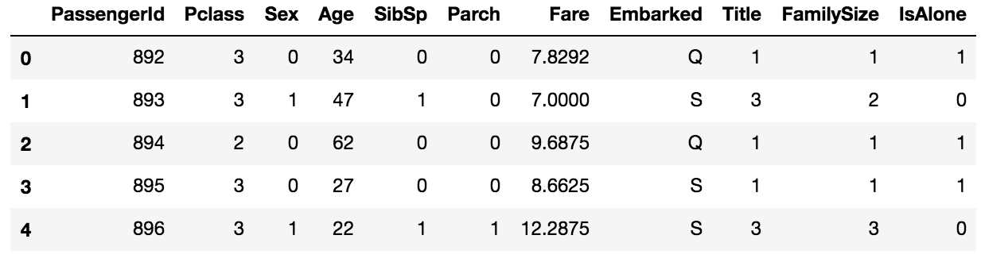
Titanic Survival Challenge
Survived is the target column

Slide 51
Objective: Predict who survived the sinking of the Titanic
-Is there a specific outcome for the objective? Yes, survived or not survived
-Is it a Numerical outcome or Class outcome? Class (survived or not survived)
-What type of machine learning is this: Supervised classification
-Suitable models for this type of learning KNN, SVM
-Do we have the data or is data scraping needed: Already have data
-Load data into Pandas using pd read_csv("")

Slide 52
Import the libraries
Import pandas as pd
In computer programming, pandas is a software library written for the Python programming language for data manipulation and analysis.
It offers data structures and operations for manipulating numerical tables and time series.

Slide 53
Getting to know your data
.
Import pandas as pd
train_df = pd.read_csv('./train_preprocessed.csv') test_df = pd.read_csv('./test_preprocessed.csv')

Slide 54
Exploratory Data Analysis(EDA)
How many classes are there in the target variable?
print(train_df['Survived'].value_counts(dropna='False'))

Slide 55
Analyze by describing data
Which features are available in the dataset?
Which features are categorical?
Which features are numerical?
Which features are mixed data types?
Which features may contain errors or typos?
Which features contain blank, null or empty values?
What are the data types for various features?

Slide 56
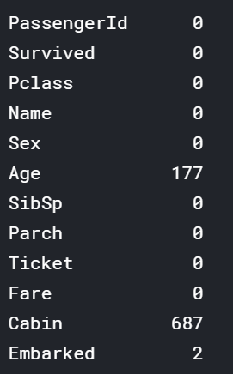
Fixing null values
print(train_df.isnull().sum())
What will be your decision after seeing this data

Slide 57
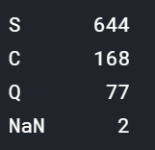
Result of null in Embarked Column
.
train_df["Embarked"] = train_df["Embarked"].fillna("S")
train_df.drop("Cabin“, axis=1,inplace=True)

Slide 58
Analyze by pivoting features
we can quickly analyze our feature correlations by pivoting features against each other
We can only do so at this stage for features which do not have any empty values.
It also makes sense doing so only for features which are categorical (Sex), ordinal (Pclass) or discrete (SibSp, Parch) type
Pclass: We observe significant correlation (>0.5) among Pclass=1 and Survived
We decide to include this feature in our model.
train_df[['Pclass', 'Survived']].groupby(['Pclass'], as_index=False).mean()
.sort_values(by='Survived', ascending=False)
Pclass | Survived
0 | 1 | 0.629630
1 | 2 | 0.472826
2 | 3 | 0.242363

Slide 59
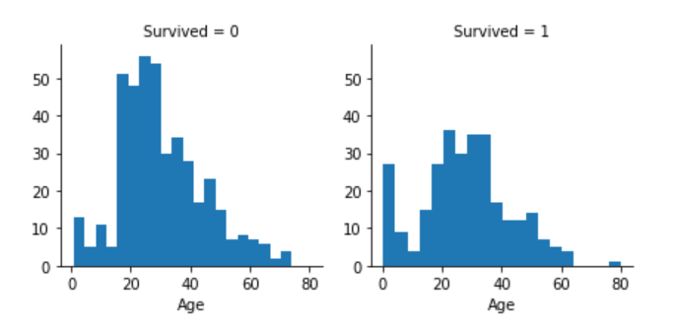
Analyze by visualizing data
A histogram chart is useful for analyzing continuous numerical variables like Age where banding or ranges will help identify useful patterns.
g = sns.FacetGrid(train_df, col='Survived’)
g.map(plt.hist, 'Age', bins=20)

Slide 60
Analyze by visualizing data
Observations:
Infants (Age <=4) had high survival rate.
Oldest passengers (Age = 80) survived.
Large number of 15-25 year olds did not survive.
Most passengers are in 15-35 age range.
Decisions:
This simple analysis confirms our assumptions as decisions for subsequent workflow stages.
We should consider Age in our model training.
Complete the Age feature for null values.
We should band age groups.

Slide 61
Correcting by dropping features
By dropping features we are dealing with fewer data points.
Based on our assumptions and decisions we want to drop the Cabin and Ticket features.
Note that where applicable we perform operations on both training and testing datasets together to stay consistent.
train_df = train_df.drop(['Ticket', 'Cabin'], axis=1)
test_df = test_df.drop(['Ticket', 'Cabin'], axis=1)
combine = [train_df, test_df]

Slide 62
Converting a categorical feature
Let us start by converting Sex feature to a new feature called Gender where female=1 and male=0
for dataset in combine:
dataset['Sex'] = dataset['Sex'].map( {'female': 1, 'male': 0} ).astype(int)

Slide 63
Reading data
train_df = pd.read_csv('./train_preprocessed.csv') test_df = pd.read_csv('./test_preprocessed.csv') X_train = train_df.drop("Survived",axis=1) Y_train = train_df["Survived"] X_test = test_df.drop("PassengerId",axis=1).copy() print(train_df[train_df.isnull().any(axis=1)])

Slide 64
Train the model and evaluation (SVM)
svc = SVC() svc.fit(X_train, Y_train) Y_pred = svc.predict(X_test) acc_svc = round(svc.score(X_train, Y_train) * 100, 2) print("svm accuracy is:", acc_svc)

Slide 65
Train the model and evaluation (KNN)
##KNN knn = KNeighborsClassifier(n_neighbors = 3) knn.fit(X_train, Y_train) Y_pred = knn.predict(X_test) acc_knn = round(knn.score(X_train, Y_train) * 100, 2) print("KNN accuracy is:",acc_knn)

Slide 66
References
https://www.analyticsvidhya.com/blog/2017/09/common-machine-learning-algorithms/

